Slide 1
Performance of ResNet Architecture With Different SGD Optimizers
Tong Wu, tw2906
Yu Wu, yw3748

Slide 2
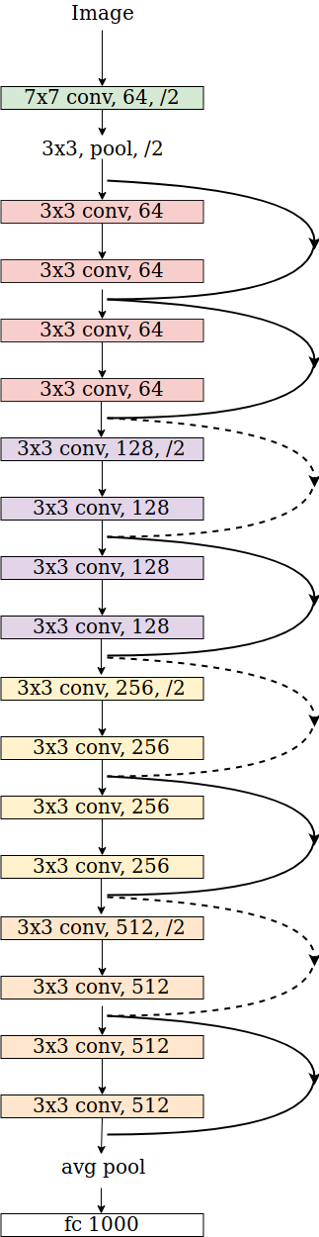
Residual neural network (ResNet)
Deep neural network architecture
Addresses the problem of vanishing gradients in very deep networks
Introduces residual connections
Allows the network to learn residual mappings
Widely used in computer vision tasks
Achive top performance in image classification, object detection and semantic segmentation
Notes:
ResNet is a type of deep neural network architecture designed to address the problem of vanishing gradients in very deep networks, by introducing residual connections that allow the network to learn residual mappings instead of full mappings. This architecture has been widely used and achieved state-of-the-art performance in many computer vision tasks such as image classification, object detection, and semantic segmentation.

Slide 3
What did ResNet Optimize
Vanishing gradients and exploding gradients problem
make network difficult to converge
Degradation problem of deeper network
performance decline as number of layers increase, even if the network converge
ResNet introduced residual connections
skip some intermediate layers
gradients can propagate through the residual connections
Notes:
The ResNet architecture addressed the problem of vanishing gradients in very deep neural networks. This occurs when gradients become too small to propagate effectively through the network during backpropagation, leading to a degradation in training performance as the network becomes deeper. ResNet introduced residual connections that allow the network to learn residual mappings, which makes it easier for the gradients to propagate through the network, even in very deep architectures.

Slide 4
Optimizers
Optimizer updates the network weight, minimize the loss function
Helps network adapt, improve performance in tasks
SGD, Adam, Nadam… May tunning learning rate manually
Optimizer influence the converge speed, robustness and performance of the model
Original ResNet paper use SGD
Now more optimizers add to comparison
Notes:
The optimizer is an essential component of the training process, it responsible for updating the network's weights to minimize the loss function. It guides the learning process, helping the network to adapt and improve its performance on the given task. The basic optimizer is SGD, which need to tune the parameters manually. And there are some adaptive optimizers extended from SGD, such as Adam and Nadam will tune automatically. The original ResNet paper use SGD with momentum as the optimizer, however there are more and more efficient and high-performance optimization algorithms come up. Hence we will use different optimizers to compare the performance.

Slide 5
Paper: Analysis of Gradient Descent Optimization Algorithms on ResNet
Discuss different optimizers performance mathematically
Apply optimizers on ResNet architecture
Train and test the model use CIFAR-10 dataset
Compare the performance, including test error and train loss, of each optimizers.
In this part, we will show the reproduce result of this paper and analysis it.
Notes:
We found a paper that implement different optimizers on ResNet and compare their performance. It’s called “Analysis of Gradient Descent Optimization Algorithm on ResNet”. In this paper, the author discuss different optimizer and implement them on ResNet and train with CIFAR-10 dataset. Then they compare the performance of each optimizer. In the next part, we will perform our reproduce result of this paper and provide some analysis for each optimizer.

Slide 6
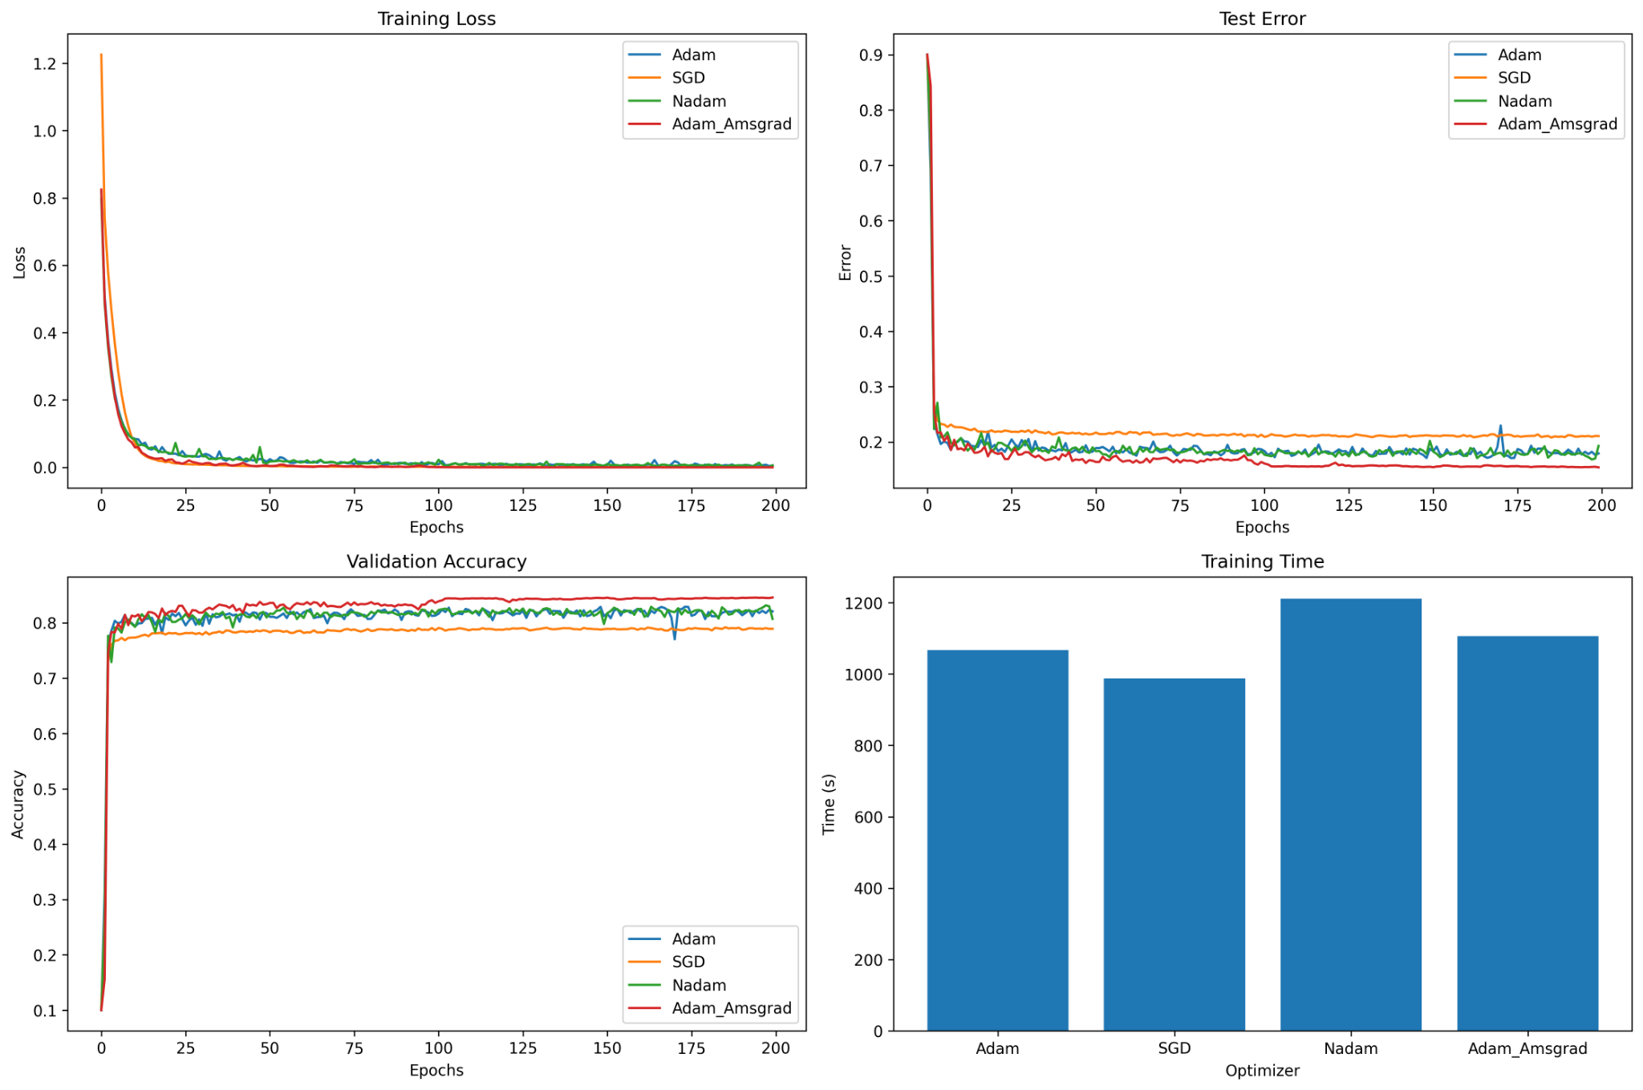
Reproduce results
Notes:
This graph shows our reproduce result. In the experiment, we use TensorFlow to implement a ResNet-18 neural network, and train it using CIFAR-10 dataset. Finally we got the data of each optimizer’s performance. From the graph, we can see that all of them converge the training loss and test error into a very low value, and maintain the accuracy around 75-80%. The blue line is Adam and green line is Nadam, they perform oscillations in each graph which shows that they may not stable compared with the AMSGrad in red line which has the best performance overall. The SGD has the highest test error and lowest accuracy, but it has the smallest training time. On the next slides, we will analysis each optimizer from its architecture and update equation.

Slide 7
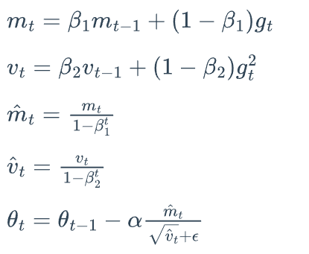
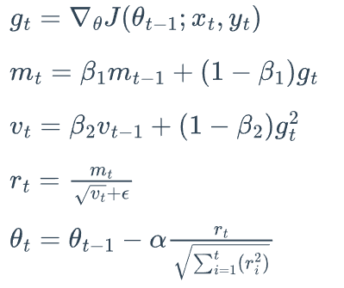
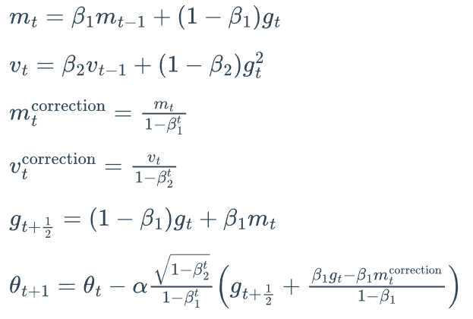

Optimizers Analysis
Adam:
Nadam:
Adam: Compute adaptive learning rate for each parameter, has high performance.
Nadam: Extension of Adam, introduce Nestrov acceleration speed up convergence and extra bias-correction step to reduce oscillation.
AMSGard: Retains the maximum of all past second moment estimates. Correction factor to ensure the gradient average is not underestimated.
SGD: only compute the loss function according to the gradient.
AMSGard:
SGD:
Notes:
Adam: Adam will compute the adaptive learning rates for each parameter. It keeps the exponentially decaying average of past squared gradients $v_k$ and gradients $m_k$. They are the estimates of first and second moment of gradient. Adam has high performance with low training loss and error. However, the learning rate of Adam may decrease too quickly when the second moment of gradients decreases in the later stages of training, it lets Adam lost some robustness.
Nadam: Nadam is an extension of Adam, it incorporates with N(Nesterov) acceleration to compute the gradient in the next step, which can help to speed up the convergence. Also, Nadam introduces extra bias-correction step to reduce oscillations during training. In the graph, it lead to similar performance compared to Adam but with better convergence speed and robustness.
AMSGrad: AMSGrad retains the maximum of all past second moment estimates to prevent sudden drops in learning rate, resulting in better optimization performance. Also, it uses a correction factor to ensure the gradient average is not underestimated during the iteration, it in order to get the better convergence performance. In general, AMSGrad has the best performance and robustness. However, it needs more time to compute.
SGD: SGD only compute the loss function according to the gradient to update the parameter, so the computing time of SGD is smaller than others. However, it doesn’t have dynamic adjusting of learning rate, so SGD has the worst performance than other adaptive optimization algorithms.

Slide 8
Padam
Padam: new algorithm.
Combines adaptive gradient methods & SGD.
Introduces partial adaptive parameter.
Addresses generalization gap.
Fast convergence & good generalization.
Notes:
Padam is a new algorithm that unifies the benefits of adaptive gradient methods like Adam and Amsgrad with SGD by introducing a partial adaptive parameter. It addresses the generalization gap issue of adaptive gradient methods in deep neural networks and
achieves fast convergence rates while generalizing.

Slide 9
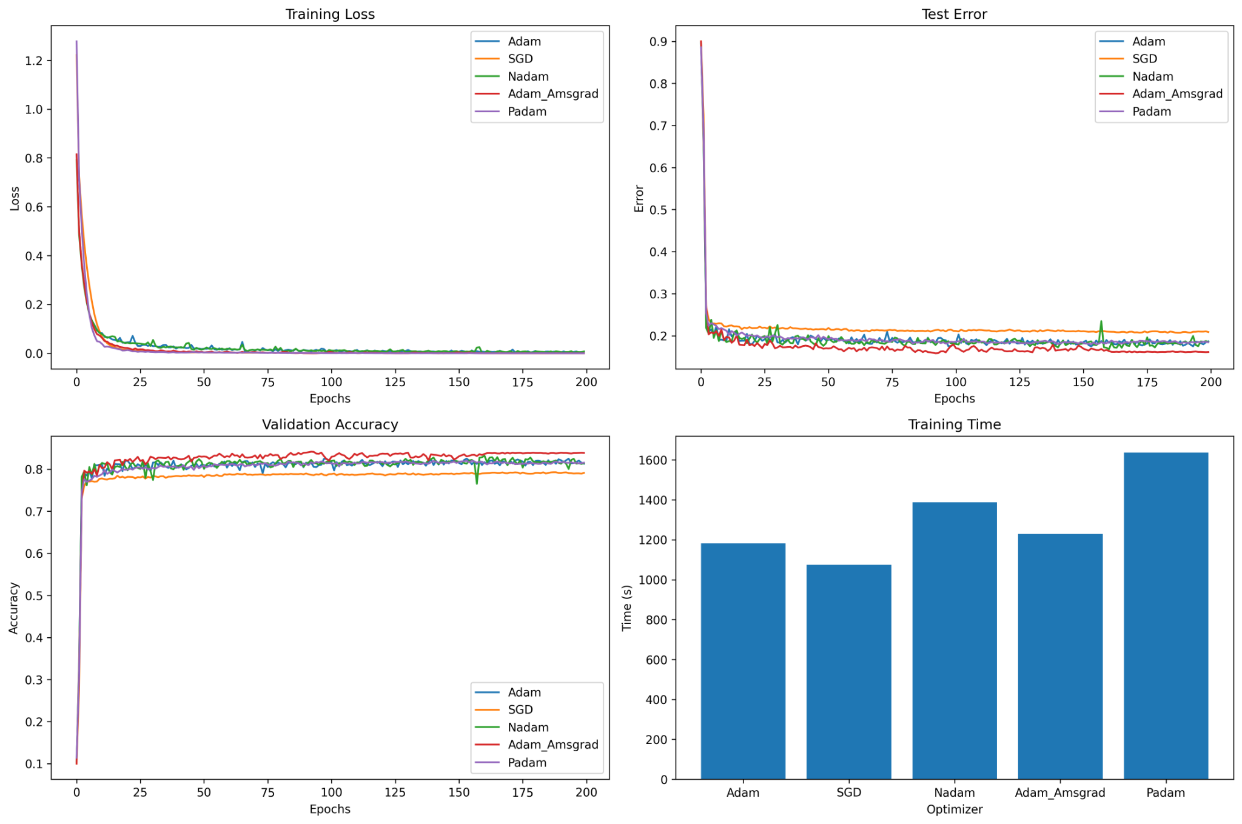
Padam vs Other optimizers
Notes:
In this experiment, ResNet-18 is used as the deep learning model, and the CIFAR-10 dataset is used for training and evaluation. The experiment runs for 200 epochs.

Slide 10
Padam Analysis
PADAM underperforms Adam_AMSGrad due to extra hyperparameter: momentum reservoir.
Momentum reservoir affects convergence speed.
Appropriate value crucial for convergence balance.
Smoother test error line from adaptive momentum mechanism.
Mechanism stabilizes optimization by updating based on gradient variance.
Notes:
The reason why PADAM did not perform as well as Adam_AMSGrad may be due to the fact that PADAM introduces an additional hyperparameter, called momentum reservoir. This hyperparameter controls the accumulation of past gradients in the optimizer, which can help the optimizer to converge faster to a better solution. However, setting this hyperparameter too high may lead to poor convergence, while setting it too low may result in slow convergence.
The reason why PADAM may have a smoother test error data line compared to other optimizers, such as Adam and SGD, may be due to its adaptive momentum reservoir mechanism. PADAM updates the momentum reservoir based on the variance of the gradients, which can effectively smooth out the variations in the gradient updates and make the optimization process more stable.

Slide 11
Conclusions
In this project, we:
Discuss the performance of ResNet
Reproduce a paper that compare performance of different optimizers on ResNet
Analysis each optimizer’s performance with its update equation
Discuss the improvement on Padam
Implement Padam on ResNet and analysis its performance

Slide 12
Work Cited
[1] He, K., Zhang, X., Ren, S., & Sun, J. (2016). Deep residual learning for image recognition. 2016 IEEE Conference on Computer Vision and Pattern Recognition (CVPR) (pp. 770-778).
[2] Grag, C., Grag, A., Raina, A. Analysis of Gradient Descent Optimization Algorithms on ResNet
[3] Chen, J., & Gu, Q. (2022). Padam: Closing the Generalization Gap of Adaptive Gradient Methods in Training Deep Neural Networks.

